Slide 1


Physics (PHY 102)Thermodynamic
Farjana Yeasmin
Lecturer in Physics, Basic Science Division
World University of Bangladesh, Dhaka-1205

Slide 2
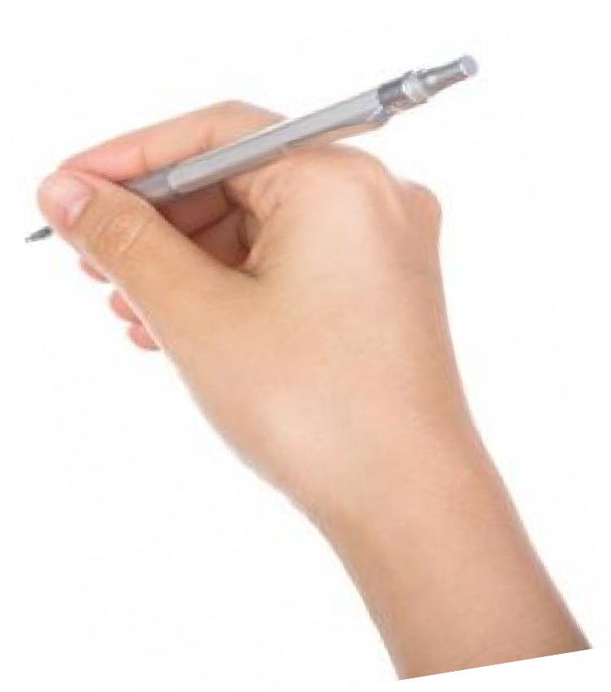
Objectives
Thermodynamics

Slide 3

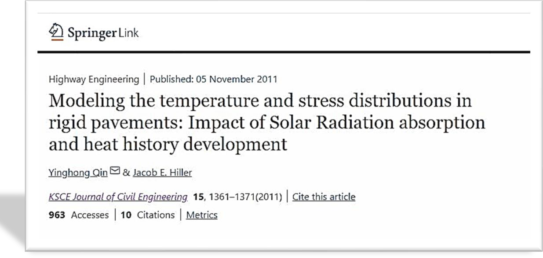
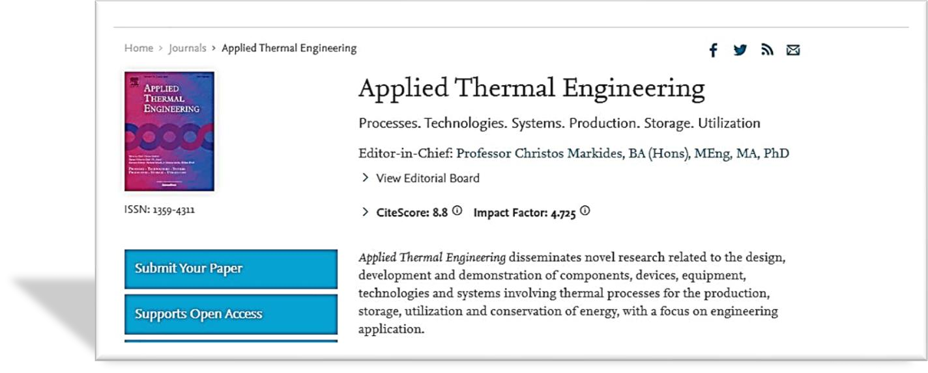
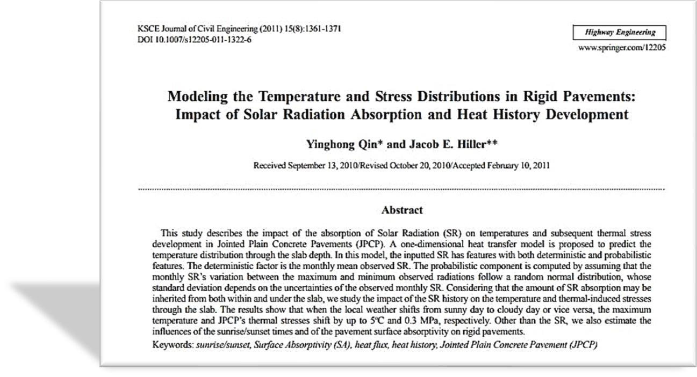
Why should we study thermodynamics?

Slide 4

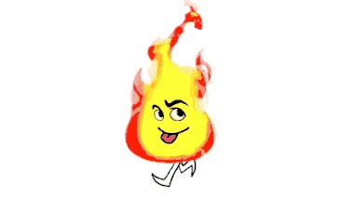
Thermodynamics
o
What is thermodynamics?
Thermodynamics=Thermo+Dynamics
Heat Motion
Hey there!!!
Just look at me. I am heat and I am moving.
That’s it. This is the simple
meaning of thermodynamics

Slide 5
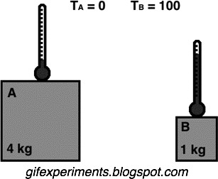
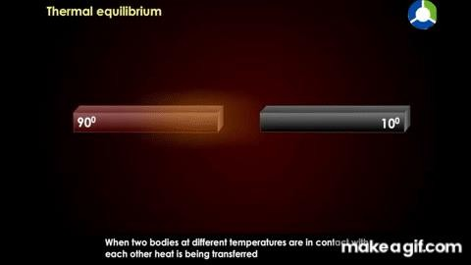
Thermal equilibrium
o Meaning
Thermal Equilibrium is when all objects in
a system are at the same temperature.
o About Thermal Equilibrium
When a hot object is placed next to a cold object energy will flow from the hotter to the cooler until they reach thermal equilibrium.
Thermal equilibrium obeys the zeroth law of thermodynamics.

Slide 6


Zeroth law of thermodynamics
Discovered
In 1935 years, Ralph H. Fowler
He came upon one text- ‘every physical quantity must be measureable in numeric term’
There was no discovery of any term like ‘TEMPERATURE’
before 1935
Realized that thermal equilibrium is significant phenomena
Thus, it gives the definition of temperature
Why this law is named
‘Zeroth’?

Slide 7
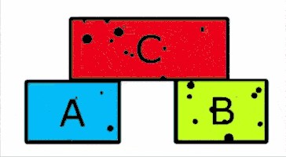

Zeroth law of thermodynamics
o Statement
If two bodies A and B are in thermal equilibrium with third body C, then body A and B are also in thermal equilibrium with each other
o Mathematically
If T_{a} =T_{c} and T_{b}=T_{c}, then according to Zeroth law of thermodynamics T_{a}=T_{b}
o What did you find from the Zeroth law of thermodynamics?
The property of TEMPERATURE
o What is Temperature?
temperature is the quantity measured by a thermometer.

Slide 8

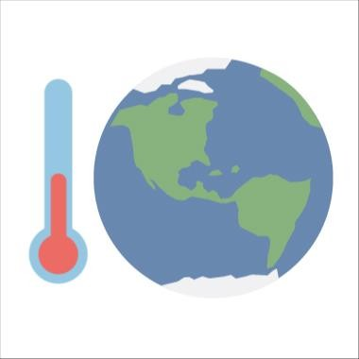
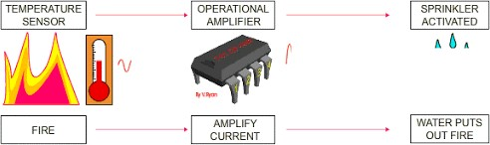
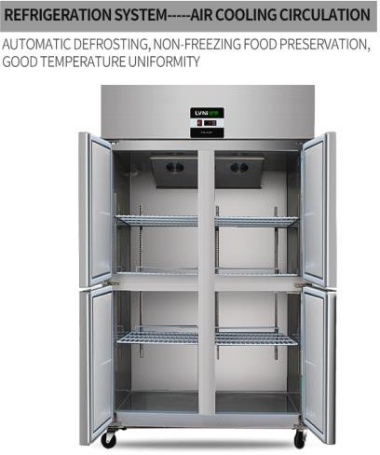
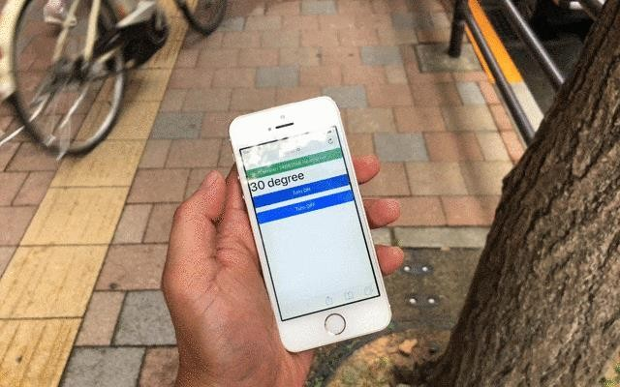
Zeroth law of thermodynamics-Applications
Application of zeroth law of thermodynamics
To measure human body temperature
To measure atmospheric temperature
Temperature measurement for industrial applications
Temperature measurement for air conditioners
Temperature measurement for refrigerator

Slide 9
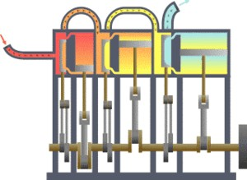
First law of Thermodynamics
First law of thermodynamics is a statement of conversion of energy
The first law states that the change in the internal energy of a system is equal to the sum of the heat gained or lost by the system and the work done by or on the system.
It can also be stated this: The change in the internal energy of a closed thermodynamic system is equal to the sum of the amount of heat energy supplied to or removed from the system and the work done on or by the system.
o The animation shows a typical thermodynamic system, showing input from a heat source on the left and output to a heat sink on the right. Work is extracted, in this case by a series of pistons.

Slide 10
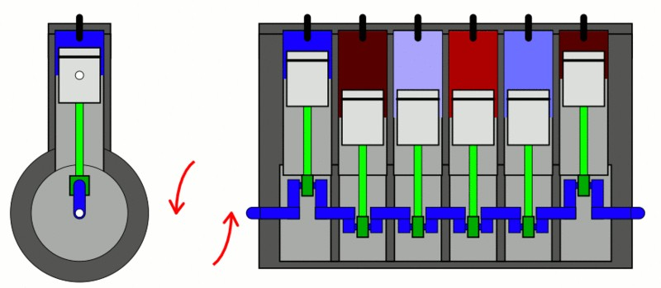
First law of Thermodynamics-Mathematically
Mathematical expression
Consider a thermodynamic system initially have internal energy E₁ absorbs, ∆Q amount of heat from its surroundings and performs ∆𝐖 amount of work and at the same time its internal energy increases to E₂
Then according to the first law of thermodynamics:
Heat supplied = increase in internal energy +work done
ΔQ = ΔΕ + ΔW
ΔQ = (U₂ - U₁) + ΔW
ΔU = U₂ - U₁
ΔQ = (U₂ - U₁) + P ΔV
ΔW = P ΔV

Slide 11
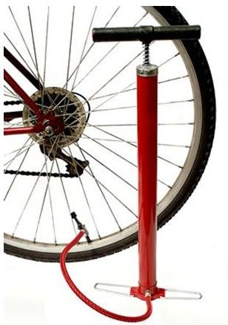
First law of Thermodynamics-Example
o What is an example of the first law of thermodynamics?
A bicycle pump provides a good example. when we pump on the handle rapidly, it becomes hot due to mechanical work done on the gas, raising they're by its internal energy. one such simple arrangement is shown in the figure.
Try to find out another example!!!!
The first law can be extended to include changes in mechanical energy =
kinetic energy K + potential energy U

Slide 12
First law of Thermodynamics-Example
o Limitations of first law of thermodynamics
The limitation of the first law of thermodynamics is that it does not say anything about the direction of flow of heat.
It does not say anything whether the process is a spontaneous process or not.
The reverse process is not possible. In actual practice, the heat doesn’t convert completely into work. If it would have been possible to convert the whole heat into work, then we could drive ships across the ocean by extracting heat from the water of the ocean.

Slide 13








Conclusions
hank you

